Slide 1
Google Cloud Functions
Pravin Y Pawar

Slide 2
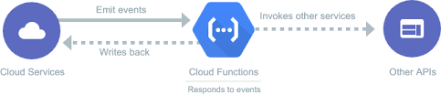
Google Cloud Functions
Scalable pay-as-you-go functions as a service (FaaS) to run your code with zero server management
No servers to provision, manage, or upgrade
Automatically scale based on the load
Integrated monitoring, logging, and debugging capability
Built-in security at role and per function level based on the principle of least privilege
Key networking capabilities for hybrid and multi-cloud scenarios

Slide 3
Key features
Simplified developer experience and increased developer velocity
Cloud Functions has a simple and intuitive developer experience
Just write code and let Google Cloud handle the operational infrastructure
Develop faster by writing and running small code snippets that respond to events
Connect to Google Cloud or third-party cloud services via triggers to streamline challenging orchestration problems
Pay only for what you use
Only billed for function’s execution time, metered to the nearest 100 milliseconds
Pay nothing when function is idle
Cloud Functions automatically spins up and backs down in response to events
Avoid lock-in with open technology
Use open source FaaS (function as a service) framework to run functions across multiple environments and prevent lock-in
Supported environments include Cloud Functions, local development environment, on-premises, Cloud Run, and other Knative-based serverless environments

Slide 4
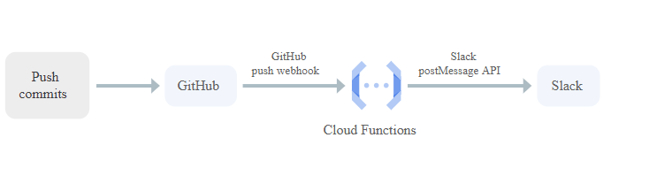
Use cases
Integration with third-party services and APIs
Use Cloud Functions to
surface out microservices via HTTP APIs
or integrate with third-party services that offer webhook integrations
to quickly extend application with powerful capabilities such as
sending a confirmation email after a successful Stripe payment
or responding to Twilio text message events

Slide 5
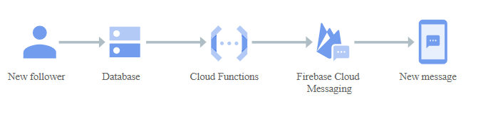
Use cases (2)
Serverless mobile back ends
Use Cloud Functions directly from Firebase to extend application functionality without spinning up a server
Run code in response to user actions, analytics, and authentication events
to keep users engaged with event-based notifications
to offload CPU- and networking-intensive tasks to Google Cloud

Slide 6
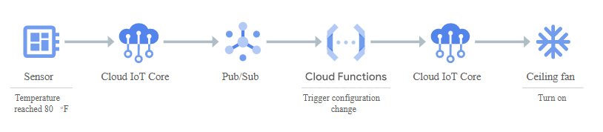
Use cases (3)
Serverless IoT back ends
Use Cloud Functions with Cloud IoT Core and other fully managed services to build back ends for
Internet of Things (IoT) device telemetry data collection
real-time processing
and analysis
Cloud Functions allows to apply custom logic to each event as it arrives

Slide 7
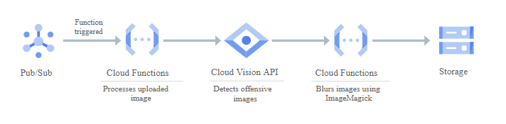
Use cases (4)
Real-time stream processing
Use Cloud Functions to respond to events from Pub/Sub to process, transform, and enrich streaming data in
transaction processing
click-stream analysis
application activity tracking
IoT device telemetry
social media analysis
and other types of applications

Slide 8
Thank You!
Reference :
GCP Serverless Computing Product pages
In our next session:

